Slide 1
Smart Curtain System
CDR Presentation
Team 3N3
Notes:
Arthur

Slide 2
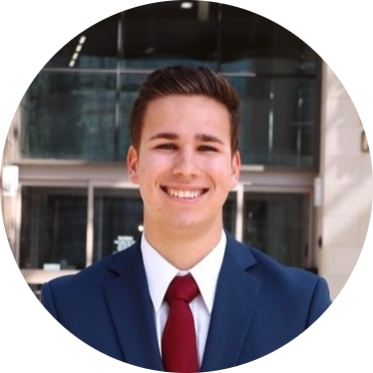
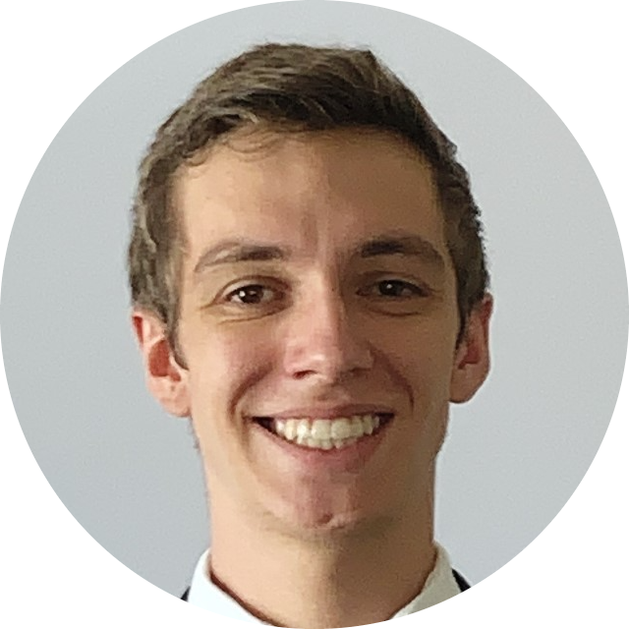
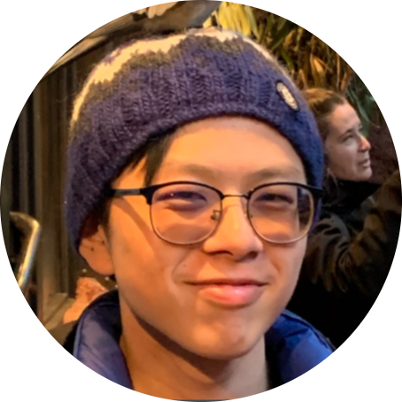
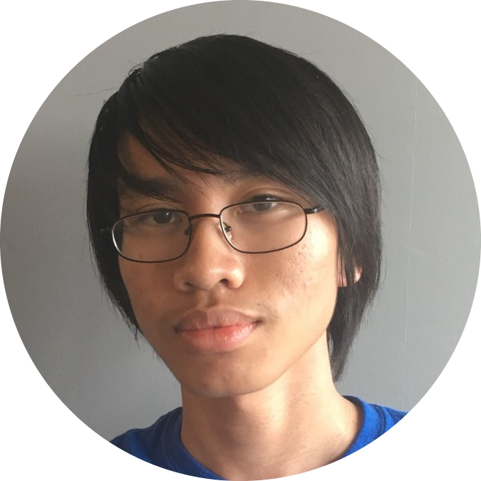
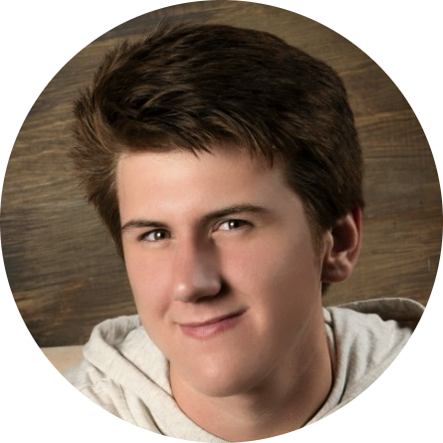
Meet the Team
Arthur Chen, ‘22
Project Leader
David Erdner, ‘22
Systems Design
James Streets ‘22
Hardware Design
Pierre Vu, ‘22
Software Design
Caleb Key, ‘22
Testing, Technical Reporting
Notes:
https://crop-circle.imageonline.co/
Arthur

Slide 3
Agenda
Introduction
Proposed Design
Project Management
Preliminary Results
Notes:
Arthur

Slide 4

Introduction to Smart Curtain System
Our goals for this system are simple:
Measure Environment and Surroundings
Automatically Control Curtains via Android Application
Save Energy by Opening/Closing Curtains Based on Environment

Slide 5
Review of Project
Needs Overview
Objectives
Design Constraints
Notes:
Caleb Start

Slide 6
Proposed Design - Updates
Committed to Android app development
Flexible design (bluetooth)
Leftover budget for hardware changes

Slide 7
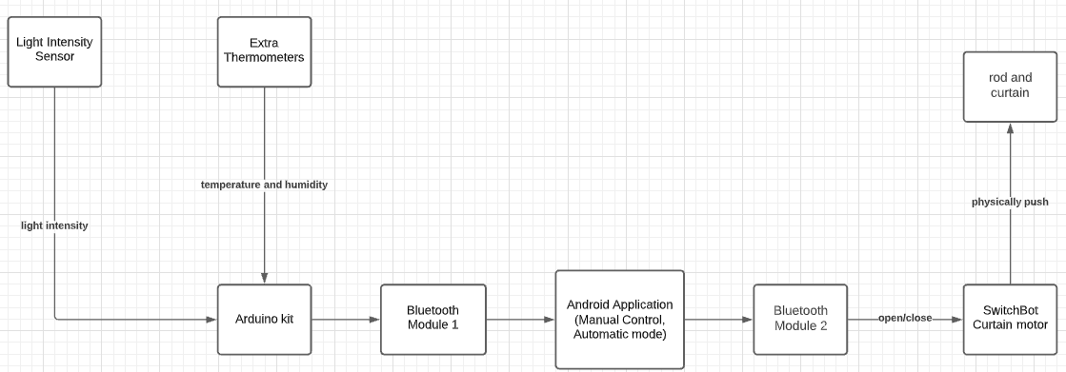
High Level Design of the Smart Curtain
Notes:
Pierre

Slide 8
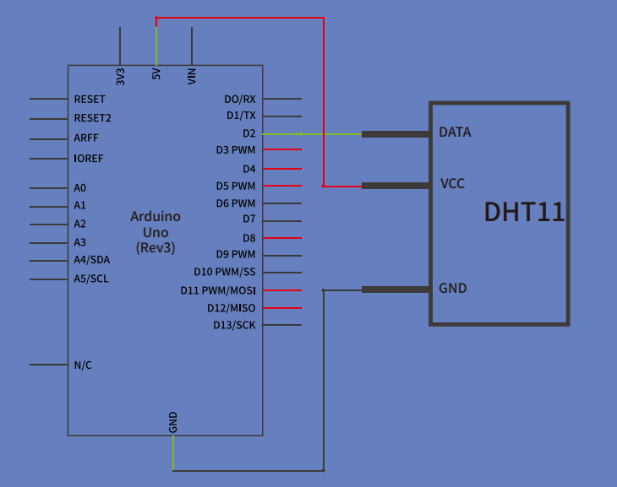
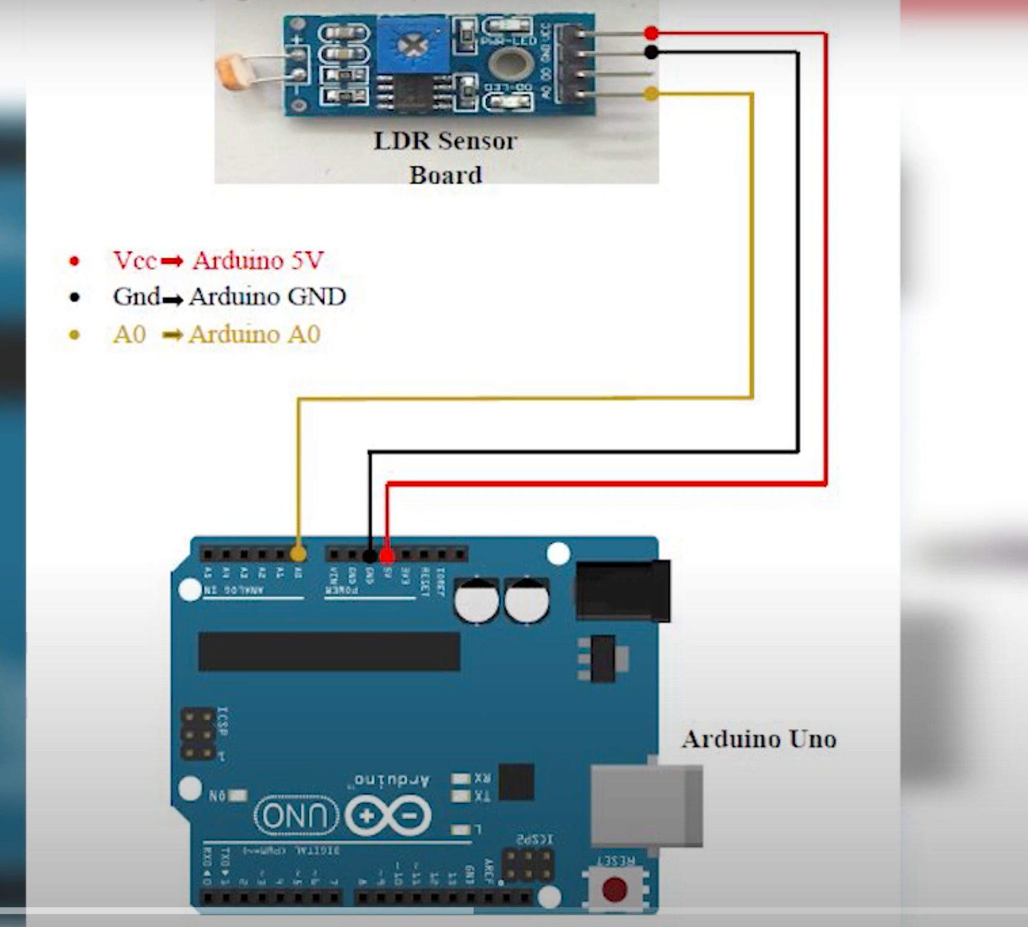
Module-Wise Specifications

Slide 9
Project Management
5 Main Roles:
Team Leader
System Designer
Software Designer
Hardware Designer
Testing
Each person will be mainly responsible for one role
Communication and help between roles is critical
Discord for communication, Gantt and Flow Charts for task and schedule management, multiple weekly in person meetings
Notes:
David Start

Slide 10
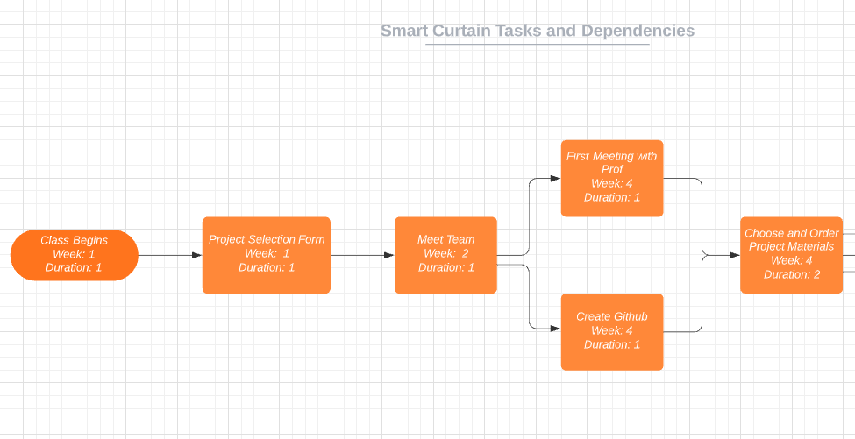
Updated Task and Schedule Flow Chart

Slide 11
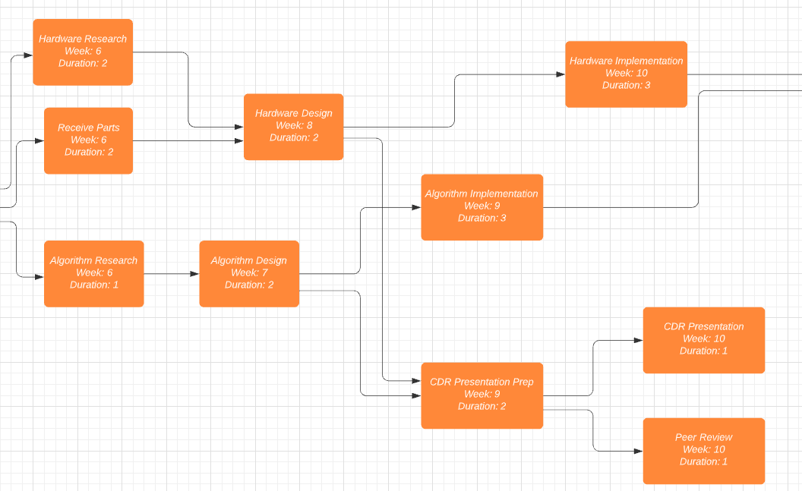
Updated Task and Schedule Flow Chart (cont. )

Slide 12
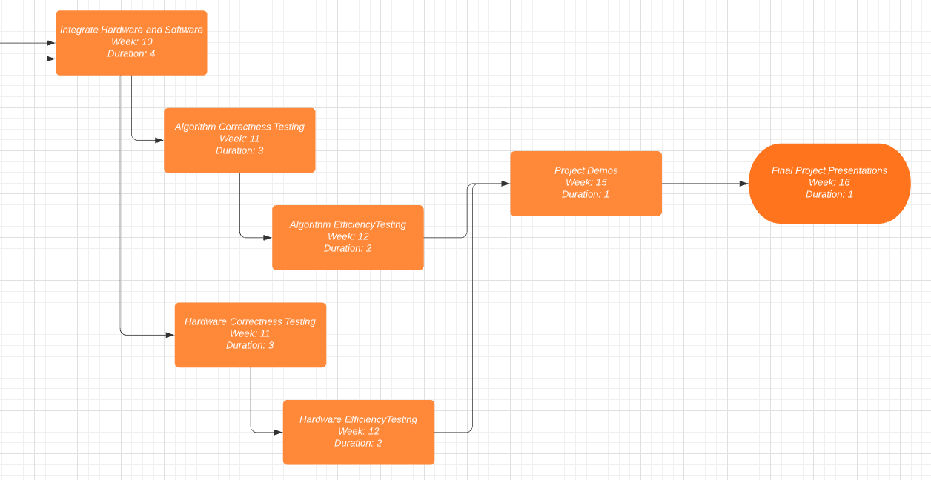
Updated Task and Schedule Flow Chart (cont. )

Slide 13
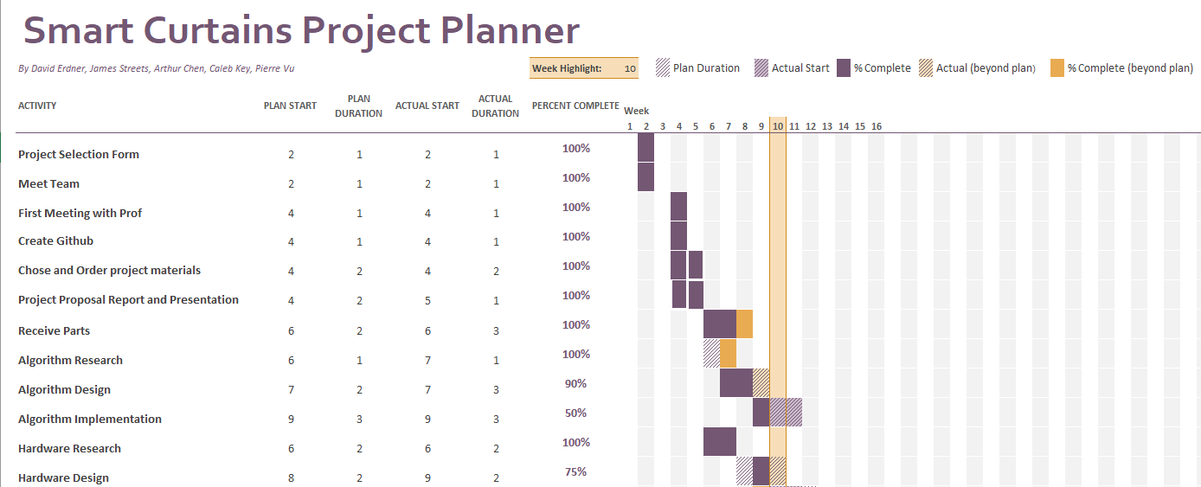
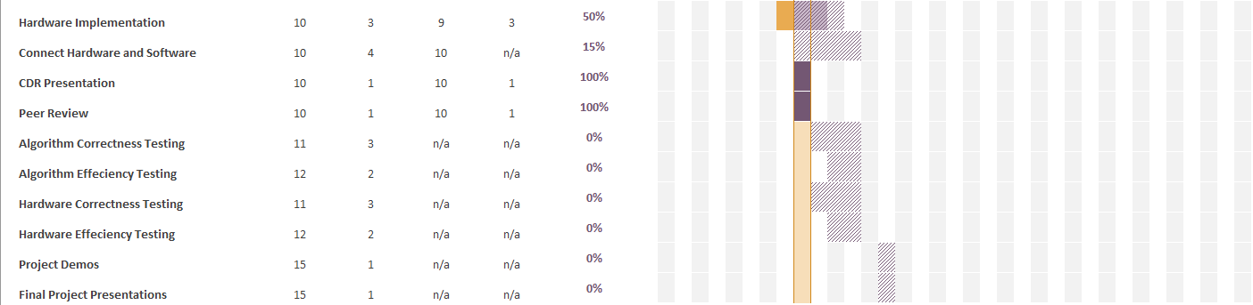
Updated
Gantt
Chart

Slide 14
Updated Validation Process
Component Testing (Hardware and Software)
Integration Testing
Integrate hardware and software piece by piece
Satisfactory hardware frequency for software input
System Testing separated into 2 parts:
Manual Testing
Automatic Testing
Notes:
Pierre end

Slide 15
Updated Division of Labor
Android app frontend
Android app algorithm implementation
Algorithm correctness and efficiency testing
Arduino hardware code for data input and output
Software and Hardware synchronization
Hardware correctness and efficiency testing
System-level testing
Management-related design and documentation

Slide 16
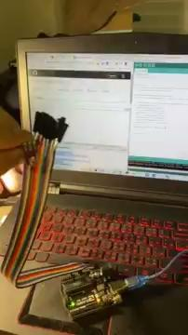
Preliminary Results - Demos

Slide 17
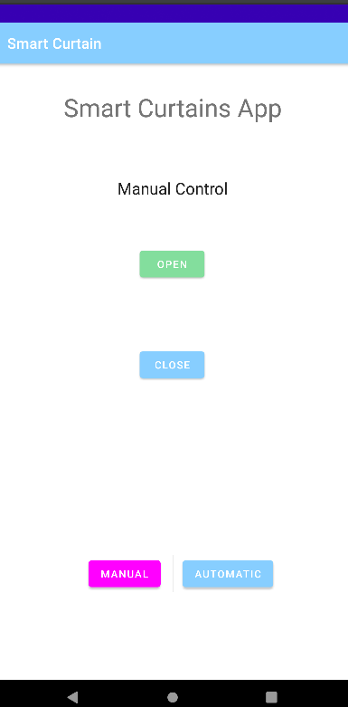
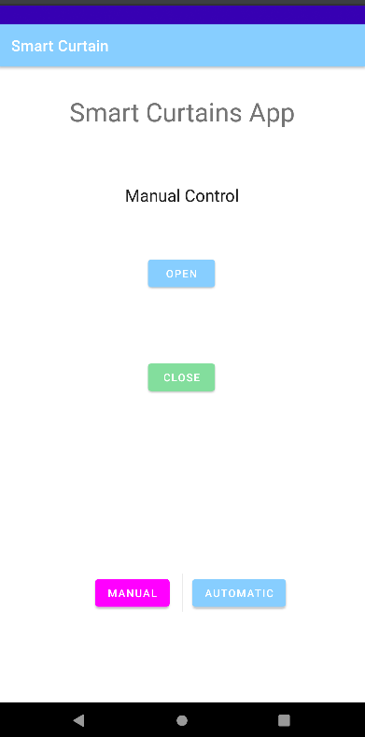
Preliminary Results - Demos

Slide 18
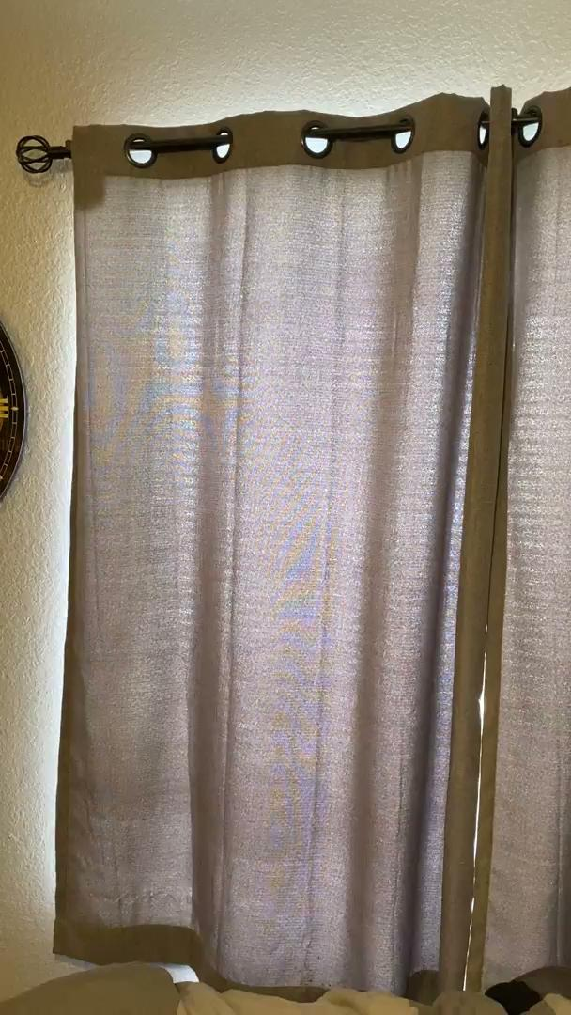
Preliminary Results - Demos

Slide 19
Conclusion
Smart Curtain System development for both software and hardware is on track
Our system design switched from Arduino-Centered to Android-Centered
The current team management techniques work effectively

Slide 20
Questions?
Notes:
David End

